Slide 1
RepQuest Project Design
Dylan Hulon, Austin Jones, Benjamin Johnson, Jaylen Cook

Slide 2
We are RepQuest!! (Agenda)
We will be discussing the design architecture of RepQuest.
Or in other words, how the application will be designed.
We will also be discussing how the application will function.
We will be discussing and presenting subject matters about the,
Gamification
Block Diagram
Component Diagram
Entity-Relationship Diagram (ERD)
User Interface (or StoryBoard)
Storage Documentation

Slide 3
Basic Description (refresher)
To begin, RepQuest will be an application that runs on Android that allows the user to create workout templates, upload workouts, and monitor their progress, history, statistics, and goals!
In addition to this, we plan to implement a gamification layer to the application that includes a small avatar to represent the user. The goal of this is to help enhance the user’s overall experience of the application!

Slide 4

Gamification Layer
The gamification layer will enhance the user’s experience, and appeal to different groups of individuals.
Where the user, achieves goals, will earn experience points(EXP) and have an avatar that represents the users!

Slide 5
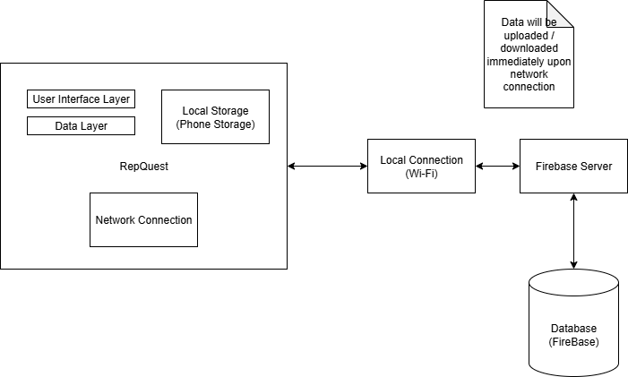
Block Diagram
The block diagram describes the three main component of the application.
The Firebase Server & Database,
The local/network connection layer,
The User Interface layer
Firebase Server & Database
Firebase database that retrieves and stores data.
Firebase server that handles the requests to retrieve and store data from the database.
Data Syncing
Data can be synced over WiFi or a service provider internet (cell phone service)
Data is then uploaded and downloaded periodically.
Notes:
The block diagram describes the three main component of the application, the Firebase Server & Database, the local/network connection layer, and the User Interface layer.
The firebase database retrieves and stores data.
The firebase server handles the requests to retrieve and store data from the database.
Data can be synced over a WiFi connection or service provider internet, like cellular data.
Data will then be uploaded and downloaded periodically.
All data will be saved once daily.
Certain actions will cause an immediate save to happen, including but not limited to:
Creating a Workout Template
Completing a Workout
Confirming a change in Settings

Slide 6
Component Diagram
The component diagram shows the main components and how they function together within the application.
Begins with the starting of the application and pulling/uploading saved data from Firebase Server & Database.
The User Interface is then next seen where the user can either begin a workout, edit/create templates, view history, statistics, and or goals.
The gamification of the application will reward the user experience points (EXP) and updates their history, statistics, and goals.
Notes:
The component diagram shows the main components and how they function together within the application.
It begins when the application is started, which pulls and uploads saved data from the firebase server and database.
The user will then see the user interface, where they can begin a workout, edit or create templates, and view their history, statistics, or goals.
The gamification aspect of the application will reward the user with experience points and then update their history, statistics, and goals.

Slide 7
Component Diagram (2)
To go further into detail, if the user begins a workout, the user goes through the user interface to begin.
Once the workout is completed,
If there are any goals hit or experience points earned those are logged within the History/Statistics/Goal location of the user Interface.
The information is then uploaded to the database for storage, and can be retrieved later for viewing (history tab).
Or the user can save the workout and create their own template!
If they don’t like that workout later, it can be removed and or changed through the user interface.
Notes:
Specifically, if the user begins a workout, they will first have to interact with the user interface.
Once their workout is completed, if there are any goals hit or experience points earned, they will be logged within the corresponding location in the UI for history, statistics, or goals.
This information is then uploaded to the database so it can be stored and later retrieved and viewed on the history tab.
The user can also save their workout as a template, which can later be removed or changed through the user interface.

Slide 8
ERD (Entity-Relationship Diagram)
The Entity-Relationship Diagram illustrates the interaction between the three main data storing components of the application.
Each user can have zero or more exercises and zero or more workouts.
Their primary key is the user id (int)
Each exercise is included in one or more workouts, and belongs to one user.
Its primary key is the exercise id (int)
Its foreign key is the user id (int)
Its other attributes are exercise name (up to 20 chars), unit of completion (boolean, is it imperial?), number of sets (int), and rest period length (int)
Each workout contains one or more exercises, and belongs to one user.
Its primary key is the workout id (int)
Its foreign keys are the user id and exercise id (int)
Its other attributes are workout notes (up to 200 chars) and bodyweight (int)
Notes:
The Entity-Relationship Diagram shows how the three main data storing components of the application interact with one another.
Each user will have zero or more exercise and zero or more workouts.
Their primary key is a user id, which will be an int.
Each exercise is included in one or more workouts, and belongs to a single user.
Its primary key will be an exercise id, an int, and its foreign key is the user id.
It will also have the attributes of an exercise name, between one and twenty characters, a unit of completion, the number of sets for that exercise stored as an integer, and the rest period stored as an integer for the number of seconds.
The unit of completion, which can be in the imperial or metric system, is toggleable in the settings tab.
It will be a boolean, where true represents the imperial system and false for the metric system.
Finally, each workout contains one or more exercises, and belongs to one user.
Its primary key will be a workout it, an int, and its foreign keys are the user id and exercise ids.
It will also have the attributes of workout notes, between 0 and 200 characters, and bodyweight as an integer.
Like the units of completion, this will also have a method in place to convert between imperial and metric, being pounds and kilograms.

Slide 9
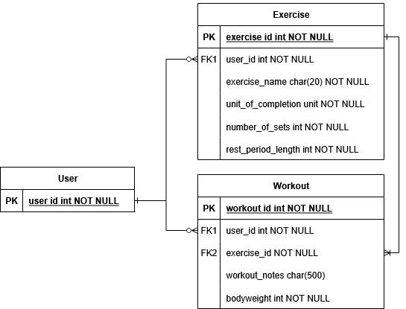
Entity-Relationship Diagram
Notes:
Here is the ERD.
You can see that the user has zero or more of both exercises and workouts, while each workout has to have at least one exercise.

Slide 10
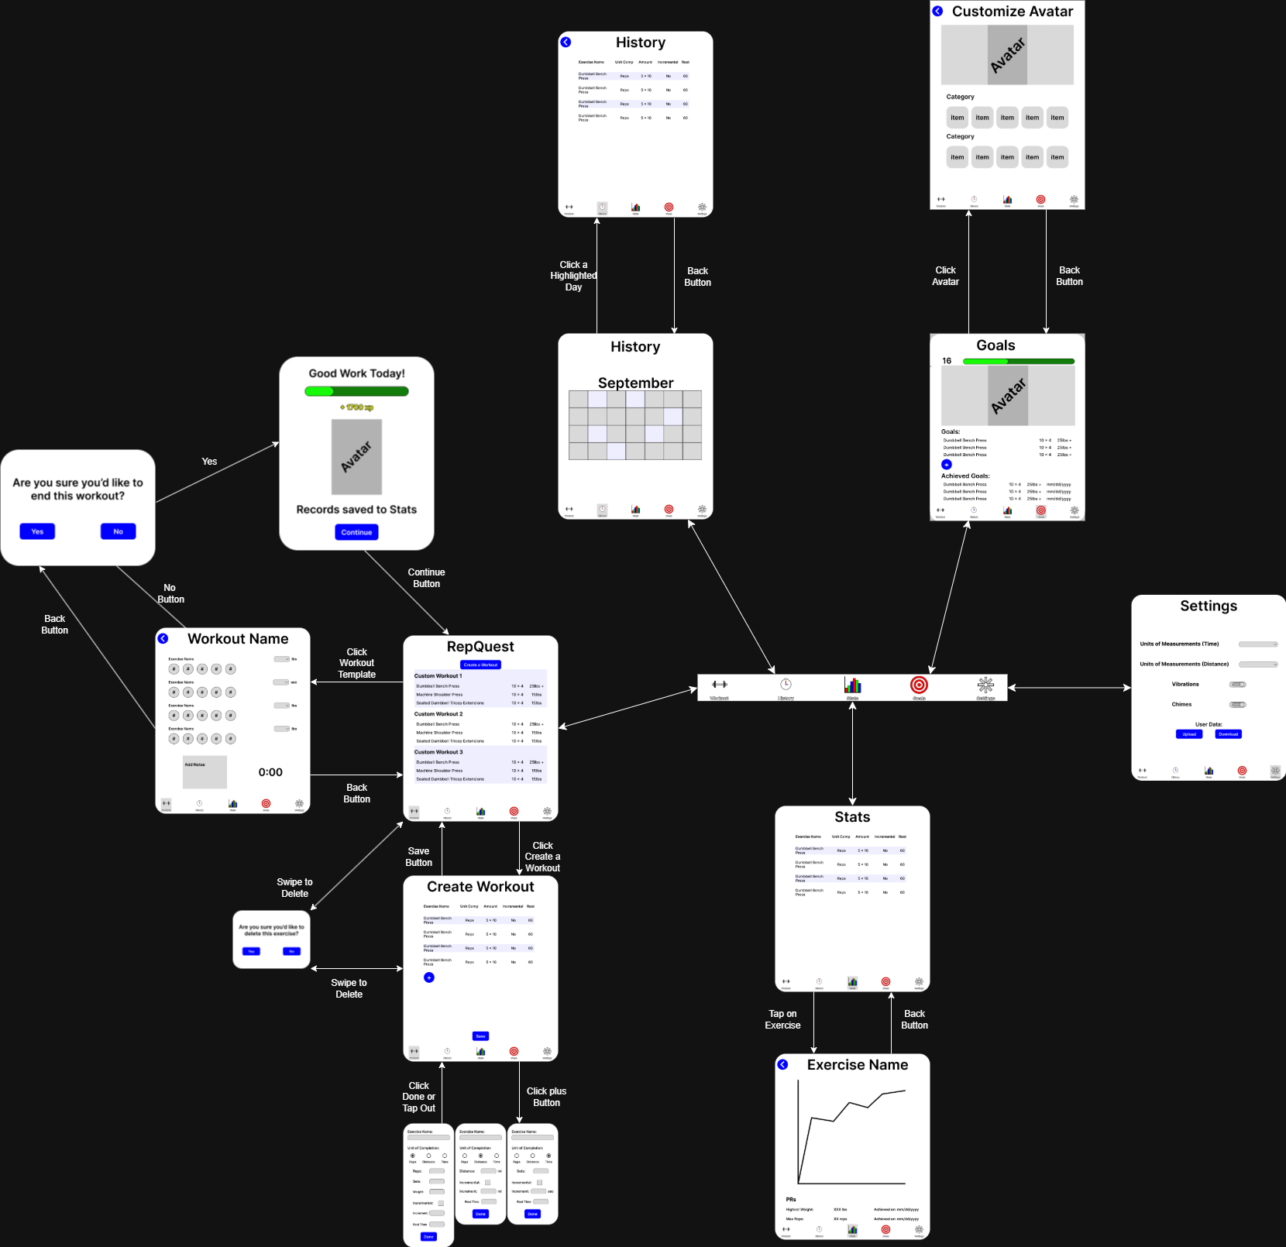
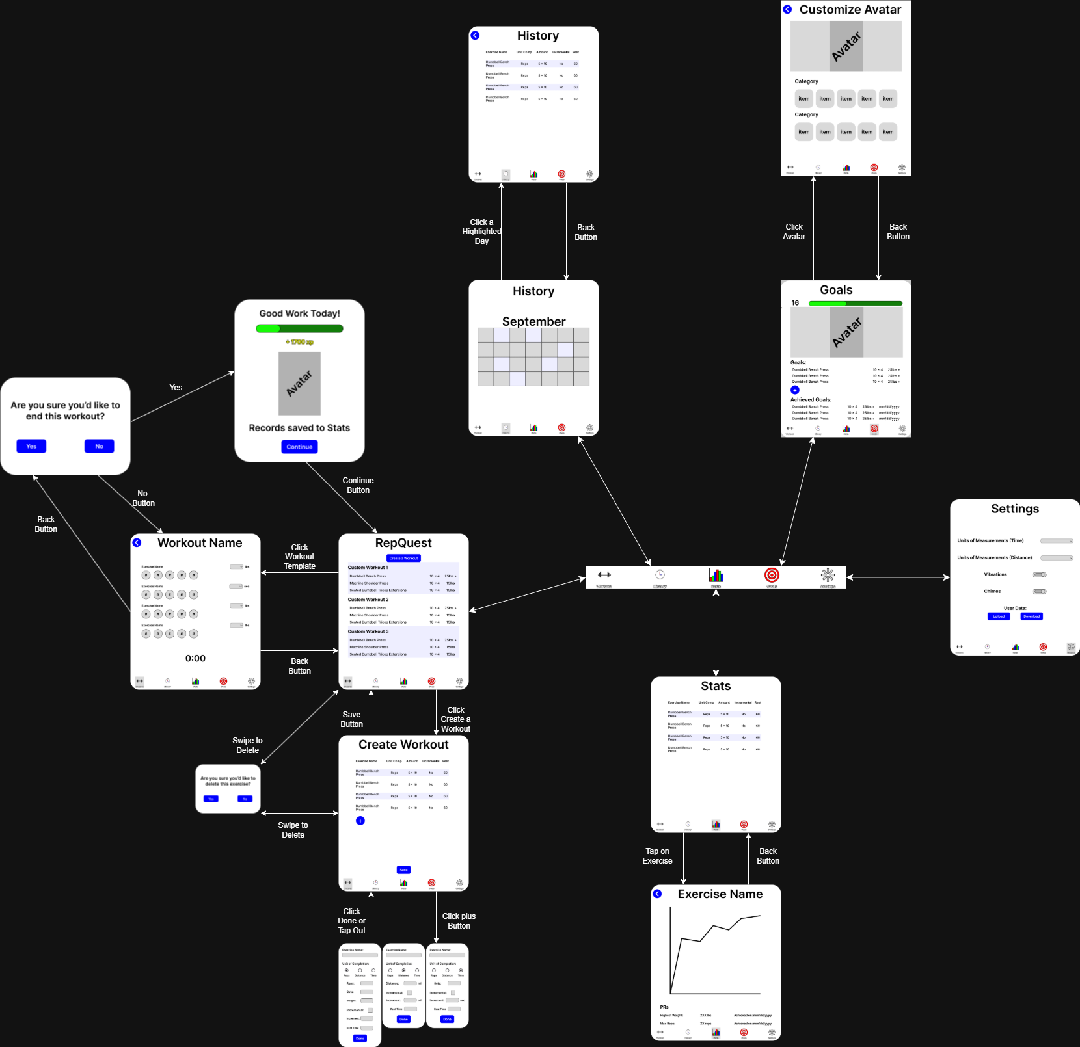
User Interface Storyboard

Slide 11
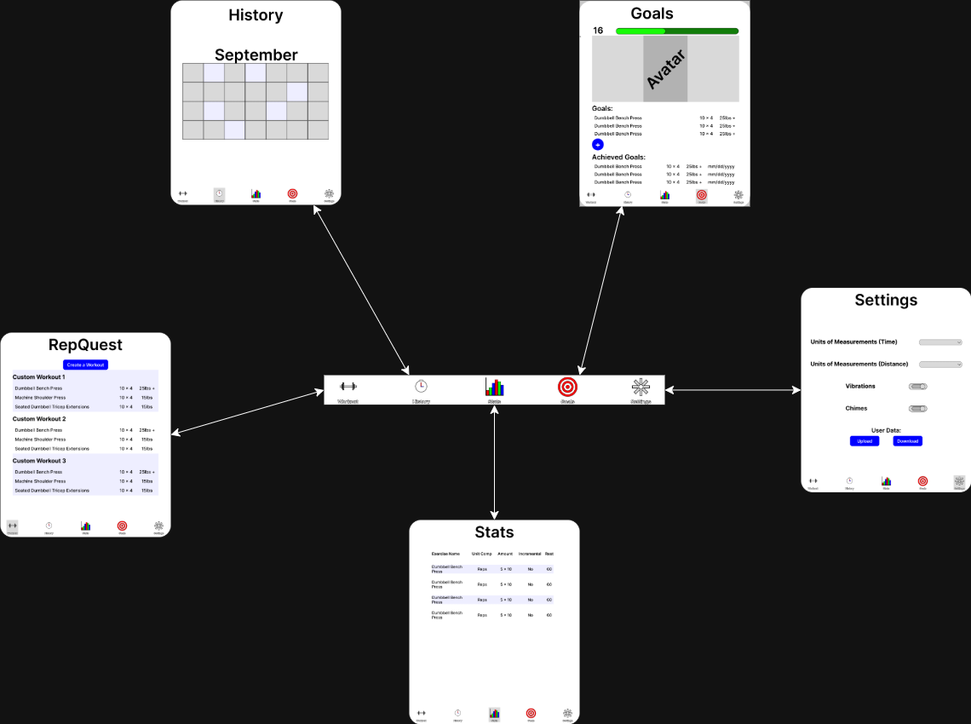
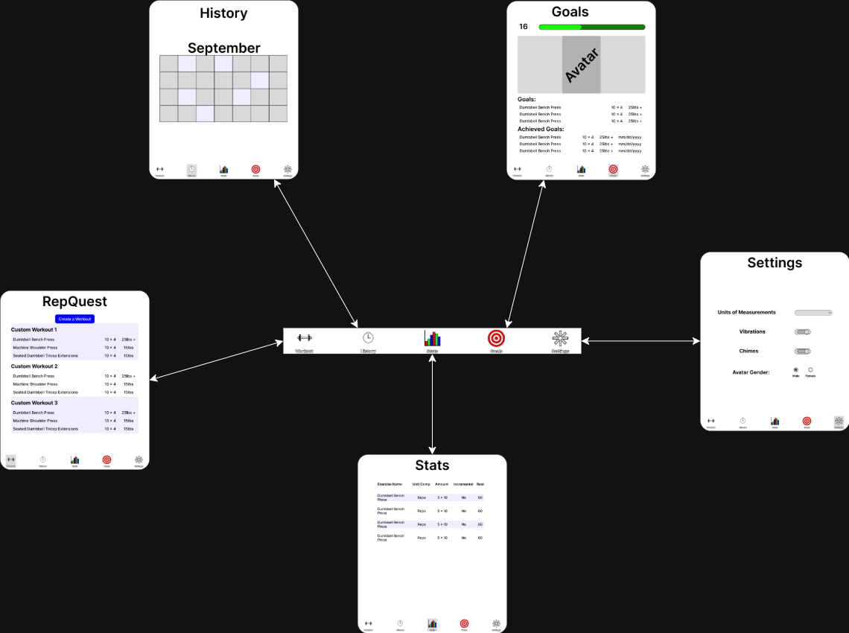

User Interface (Navbar)
Use the Navbar to switch between the “main” pages.

Slide 12
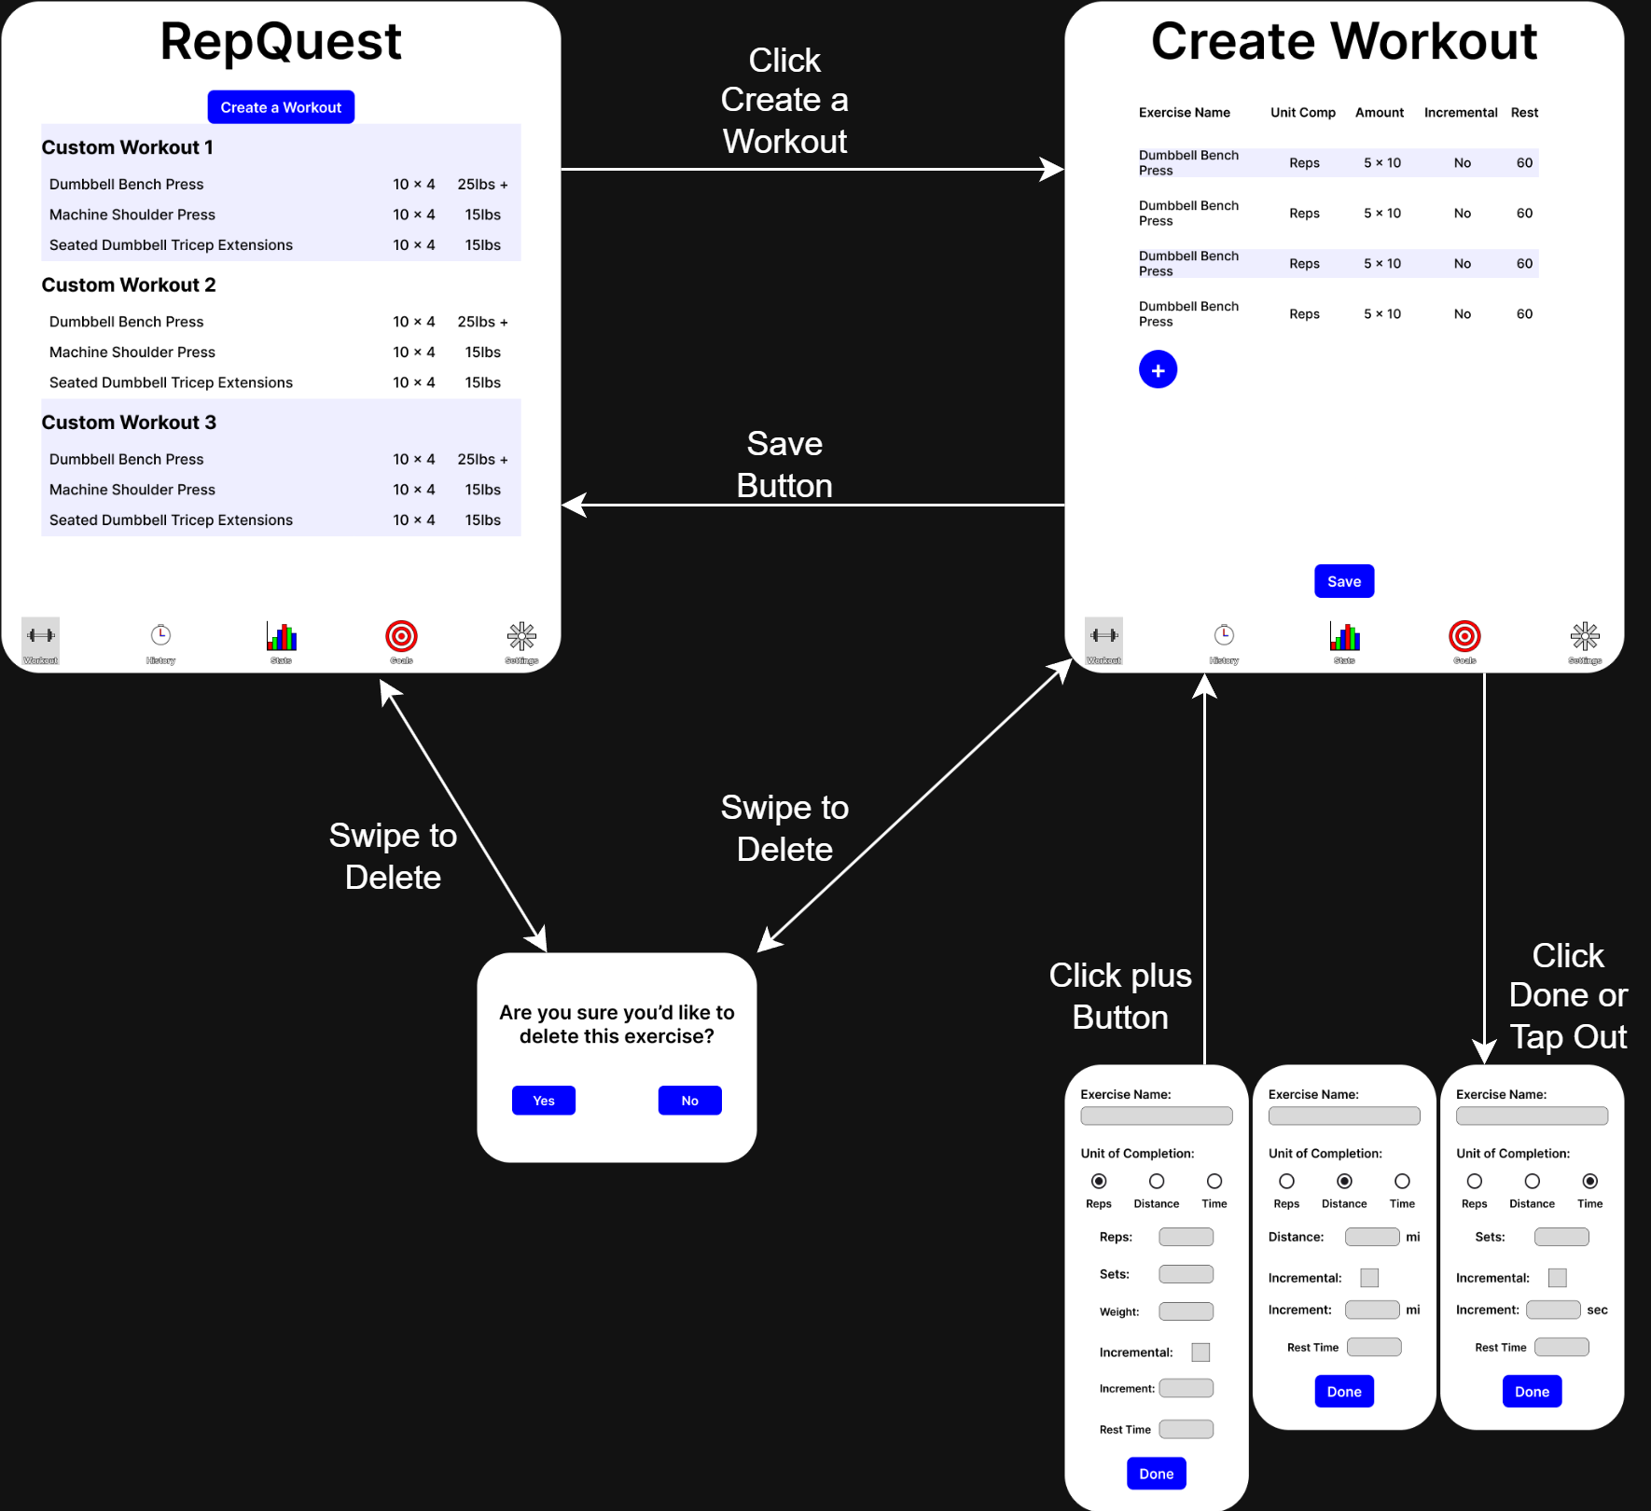
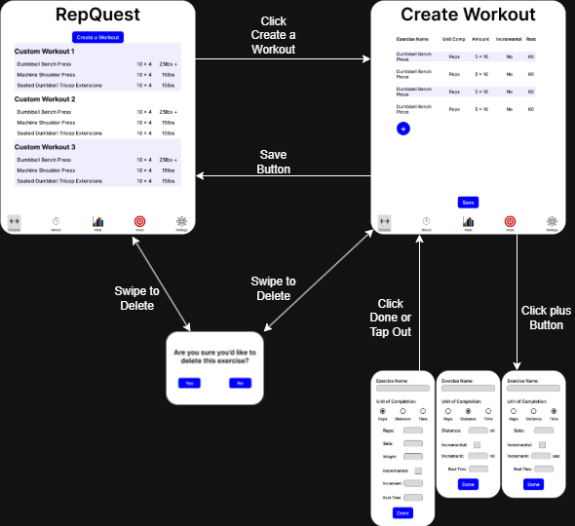
User Interface (Create Workout)
Click Create a Workout to get started
Swipe on an existing template to delete
Confirmation box will appear
Click the “+” button to add an exercise
Information will change depending on the exercise
Swipe to delete an exercise
Confirmation box will appear

Slide 13
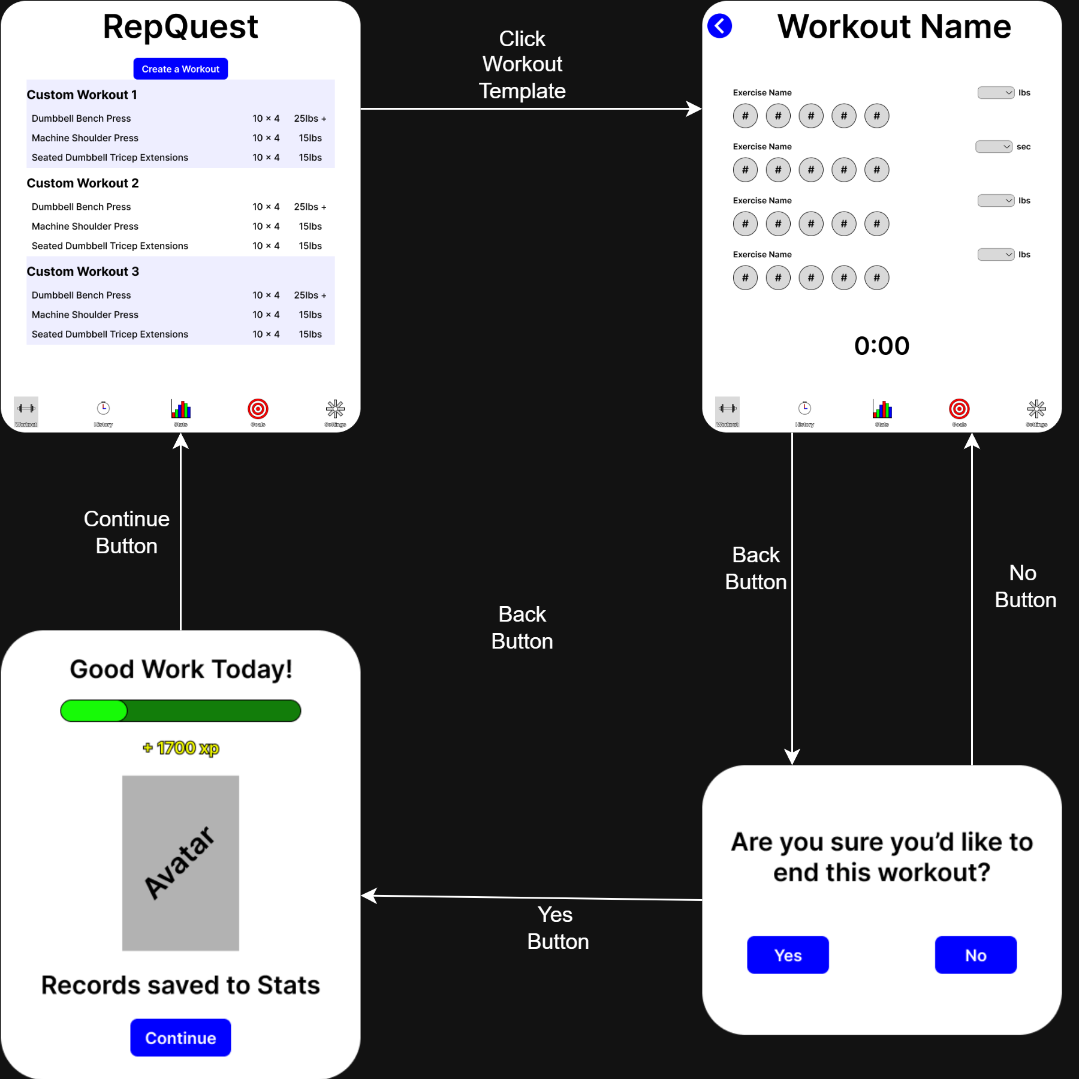


User Interface (Workout)
Click a template to start a Workout
Each Exercise has 1 completion bubble per set entered
Tap once to mark set complete, tap again to lower the number
Press the back button to quit
Confirmation box will appear
Confirming will send you to the experience screen

Slide 14
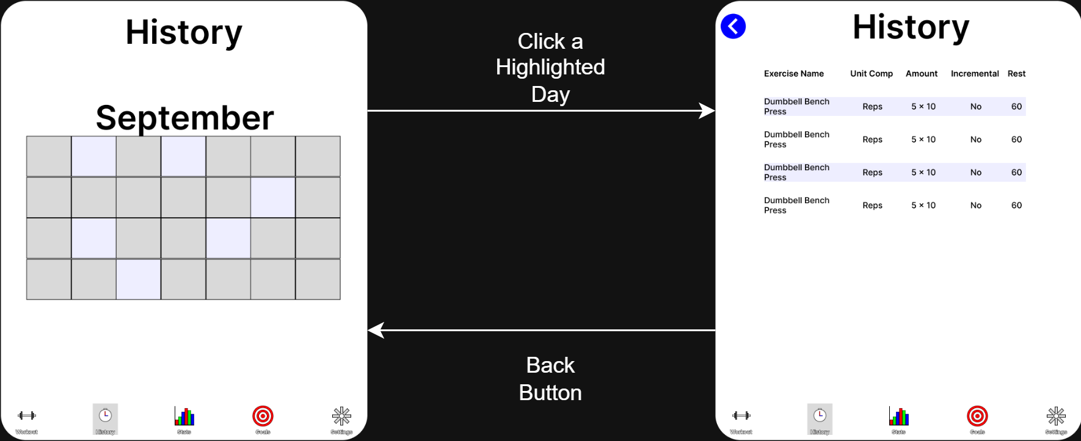
User Interface (History)
Click on a highlighted day to see the exercises and notes you have saved for that day

Slide 15
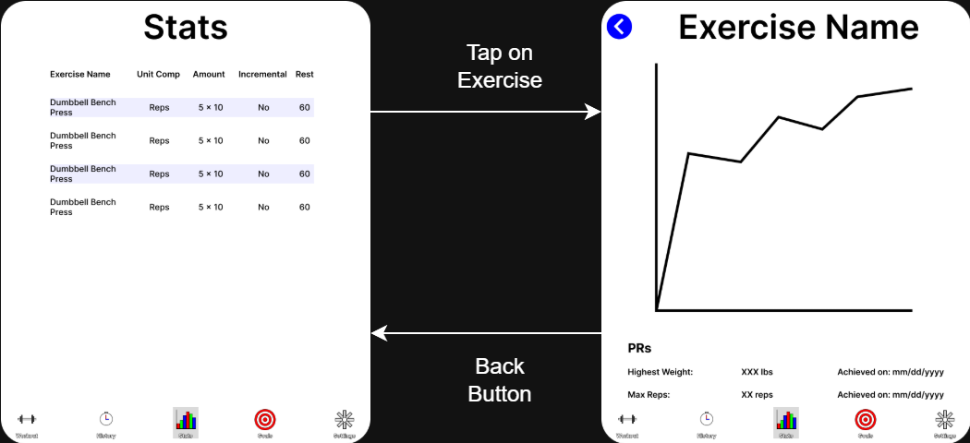
User Interface (Stats)
Click on an exercise to see how you’ve performed on an exercise over time

Slide 16
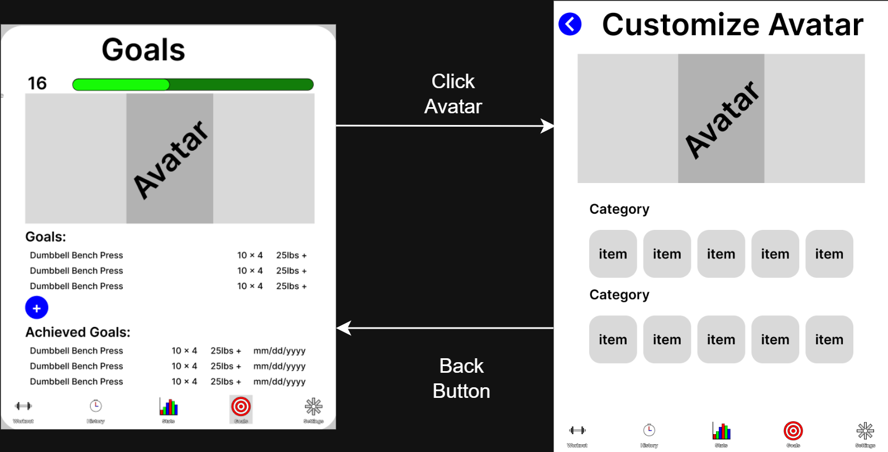
User Interface (Goals)
Here you can check and add goals you’ve made for each exercise
You can also change your avatar

Slide 17
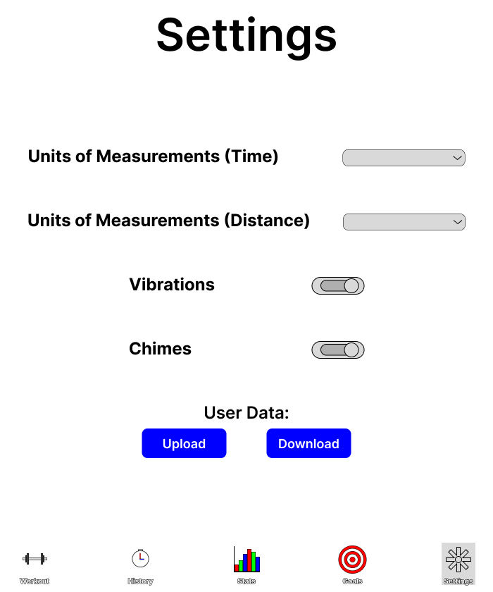
User Interface (Settings)
Change various settings
Unit of measurements
Vibrations
Chimes

Slide 18
Storage
RepQuest will be using Firebase Database and Firebase Server.
Firebase Database will store the data of the user.
Such as, templates, experience points, workouts, goals, history, and statistics.
Firebase Server will handle the authentication of the component layers.
Such as,
Syncing user data and the database.
Upload/download new templates/workouts, exp, goals, stats.
Provides real time synchronization of information.
Helps keep the database up to date.
The user will also be given the option to permit upload/download over Wi-Fi only or allow upload/download over a connection(service provider verizon, AT&T)

Slide 19
Summary (Closing)
To begin our closeout, the goal of RepQuest is intended to help user’s enjoy working out with the help of a user-friendly interface that includes an avatar!
RepQuest allows for data to be uploaded and downloaded periodically with the use of Firebase Database & Firebase Server.
Workouts, templates, goals and statistics are stored and synced in real time.
Gamification rewards users with EXP and avatar updates to encourage progress.

Slide 20
Thank you all for your time!
-RepQuest

